Slide 1
Network Flow Problem
VAIBHAV VERMA
BTECH CSE
5TH SEMESTER

Slide 2
Network Flow Problem
It is a type of network optimization problem
These types of problems can be viewed as minimizing problems.
Example: Piping system through which a quality of water must pass.
Consist of source (node which supply a commodity), sink (node which use up a commodity)
Graphs are usually directed
An edges capacity is maximum amount of flow which can pass through it.

Slide 3
Ford Fulkerson Algorithm
A simple and practical max-ﬂow algorithm.
The Ford-Fulkerson algorithm is used to detect maximum flow from start vertex to sink vertex in a given graph.
In this graph, every edge has the capacity.
Two vertices are provided named Source and Sink.
The source vertex has all outward edge, no inward edge, and the sink will have all inward edge no outward edge.
There are some constraints:
Flow on an edge doesn’t exceed the given capacity of that graph.
Incoming flow and outgoing flow will also equal for every edge, except the source and the sink.

Slide 4
Ford-Fulkerson Problem
Find an unsaturated path from the source to the sink.
Add an amount of flow to each edge in that path equal to the smallest capacity in it.
Repeat this process till no more paths can be found.
The total amount of flow added is then maximal.

Slide 5
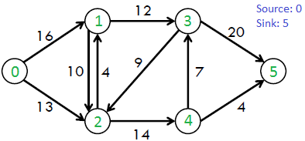
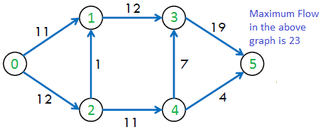
Example of ford-fulkerson

Slide 6
Naïve String Matching Algorithm
VAIBHAV VERMA
BTECH CSE
5TH SEMESTER

Slide 7
Naïve String Matching Algorithm
The naïve approach tests all the possible placement of Pattern ,
P [1.......m] relative to text T [1......n].
We try shift s = 0, 1.......n-m, successively and for each shift s.
Compare T [s+1.......s+m] to P [1......m].
This algorithm finds all valid shifts using a loop that checks the condition
P [1.......m] = T [s+1.......s+m] for each of the n - m +1 possible value of s.

Slide 8
Algorithm
NAÏVE_STRING_MATCHER (T, P)
n ← length [T]
2. m ← length [P]
3. for s ← 0 to n –m
4. do if P [1.....m] = T [s + 1....s + m]
5. then print "Pattern occurs with shift" s

Slide 9
Example
Suppose, T = 1011101110 and P = 111.
Here we will check that the pattern ‘P’ is in text ‘T’ or not.
For that we will first get the length of T and P.
Once we get the length of T and P then we will check if P[0]=T[0], if true then we will check if P[1]=T[1]. As we can see that it’s false so we will shift by 1 index. S=1
Now we will check if P[0]=T[1], as we can see it is also false again we will shift by 1 index. S=2
Now we will check if P[0]=T[2], we can see that it’s true so further we will check if P[1]=T[3], it is also true similarly we check if P[2]=T[4], it is also true.
Hene pattern matched with 2 shifts.
Similarly we will search P further in T.

Slide 10
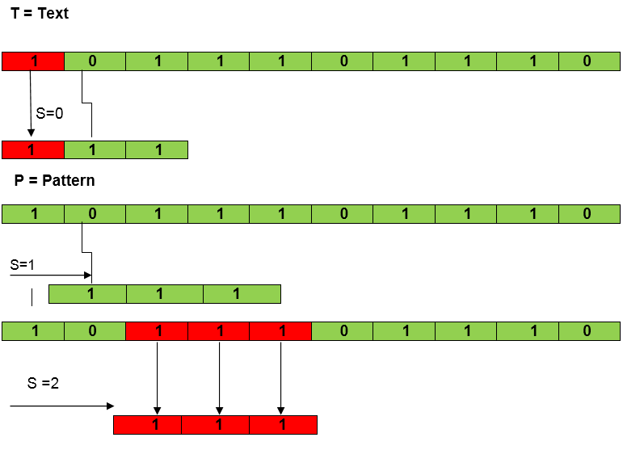
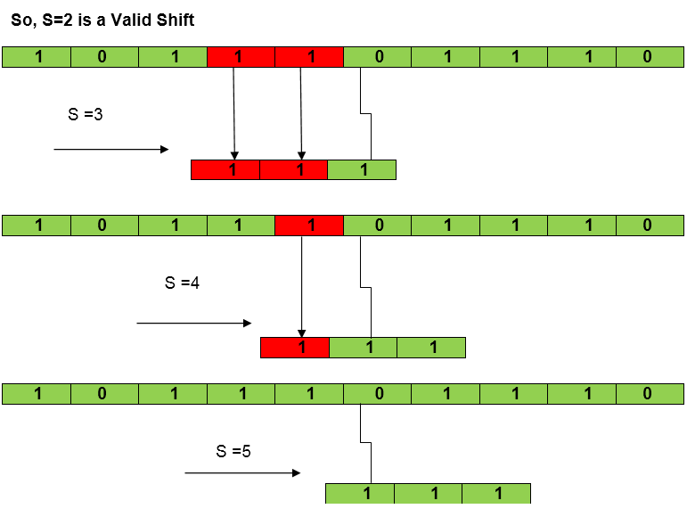

Slide 11
